Slide 1






Linux Day 1
System Settings

Slide 2
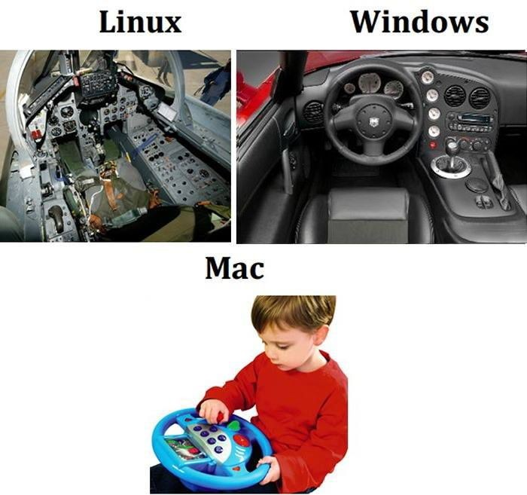

What is Linux?
Linux: the kernel which runs different distros
open-source, options/”ﬂavors” to suit different skill levels
kernel: actually “Linux”, core, manages CPU, memory, other stuff
terminal: contains the “shell”
2

Slide 3
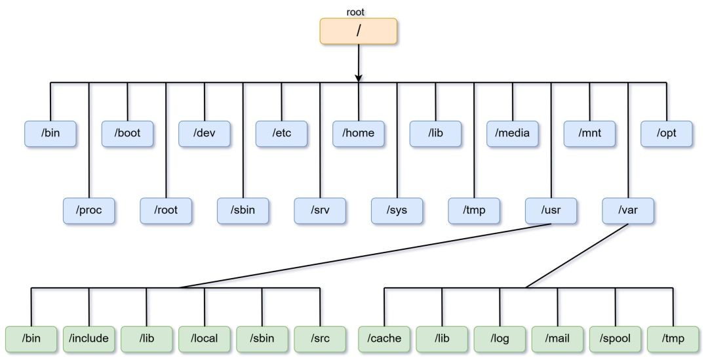
Linux Filesystem
3

Slide 4

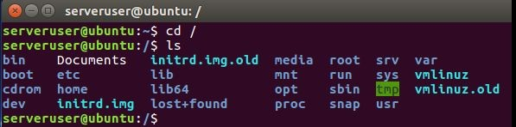
Directories and Files
- almost everything in Linux is some sort of ﬁle
- / - root directory (contains every subdirectory and ﬁle under it)
Subdirectory Examples:
/home
directories for each individual user
/etc
contains system conﬁgurations
/var
variable; stores ﬁles and logs made during system
/bin
common executable programs in system
/boot
contains kernel and startup ﬁles
/lib
contains shared libraries and ﬁles
/mnt
mount; used to temporarily mount devices & ﬁlesystem
/proc
virtual ﬁlesystem w/ kernel and process ﬁles
4

Slide 5
Basic Terminal Navigation
- pwd- print working directory (prints wherever you are located)
- cd- change directory (moves you to different directory)
- cd [ABSOLUTE PATH]; cd [RELATIVE PATH]
cd .. (brings you back one directory)
cd . (brings you to the current one)
cd - (brings you to the previously used directory)
ls- list (lists all ﬁles in current working directory)
ls -l (lists ﬁles as well as details in a long-listing format)
ls -a (lists ALL ﬁles in the directory)
ls -la (combines previous effects)
- sudo- “super user do” (gives root access for commands)
5

Slide 6
File & Directory Manipulation
touch [ﬁle_name]
creates a ﬁle
cp [ﬁle_name] [ﬁlename_of_copy or destination_directory]
copies a ﬁle under a different name if you put the ﬁlename of the copy
makes a copy in a different directory if you write the destination directory
mv [source_of_ﬁle] [destination_of_ﬁle]
moves a ﬁle to the speciﬁed location
also can be used to rename ﬁle

Slide 7
File & Directory Manipulation
rm [ﬁle_name]
removes the ﬁle
mkdir [directory_name]
creates directory
rmdir [directory_name]
removes directory
7

Slide 8
File Editing & Viewing
nano [ﬁle_name]
edits ﬁle in the command terminal
gedit [ﬁle_name]
edits ﬁle in default text editor (graphical)
cat [ﬁle_name]
prints out ﬁle contents in the terminal
less [ﬁle_name]
displays content by pages; scroll through ﬁle

Slide 9
Users
adduser [user_name]
adds the user into the system w/ standard permissions
deluser [user_name]
deletes user from the system
su [user_name]
switch user to the user given (will prompt for password)
sudo su: switches to a root user
passwd [user_name]
changes password of user
passwd -l root → locks root account
chpasswd
changes multiple passwords
user1:user1_password (this format)

Slide 10
Groups
groupadd [new_group]
creates a new group
gpasswd -a [user_name] [group]
adds a user into a group
gpasswd -d [user_name] [group]
deletes a user from the group
gpasswd -A [users,users2]
Set administrator list
- gpasswd [group]
- Prompts for new password when called by group administrator

Slide 11
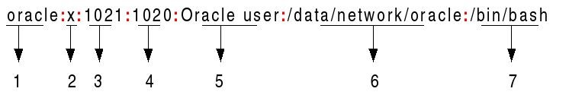
Conﬁg File /etc/passwd
- sudo nano /etc/passwd: brings you to
the /etc/passwd ﬁle to conﬁgure it
- contains information about users
name of user
password (x….?)
User ID (UID)
Group ID
Comments/GECOS (extra info)
Home directory
Shell directory

Slide 12
What to check for in
/etc/passwd
Only users have /home directories (/home/user_name)
Only users have the shell /bin/bash. System users will have /bin/false or /usr/sbin/nologin.
any user with a user ID of less than 1000 is most likely either a hidden user or a system user
- hidden users are not safe and should be deleted
If a user has a ! where the password should be, that indicates they don’t have one, which is a problem.

Slide 13
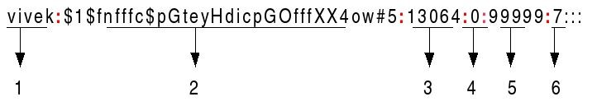
Conﬁg ﬁle /etc/shadow
- sudo nano /etc/shadow: conﬁgures shadow ﬁle
- contains the hash of the password and other password and account information
name of user
encrypted password
Last password change
Minimum password age
Max password age
warning period
Inactivity period

Slide 14
chage: a command we can use to edit /etc/shadow
The chage command changes shadow ﬁle parameters on a per user basis
Changes only affect a certain user.
Global changes belong in the /etc/login.defs ﬁle, which we’ll go into next

Slide 15
How to use chage
chage [options] [username]
chage -m 6 [user]
Changes min days of user to 6
chage -M 15 [user]
Changes max days of user to 15
chage -W 7 [user]
Warn days
chage -I 5 [user]
Inactive days
15

Slide 16
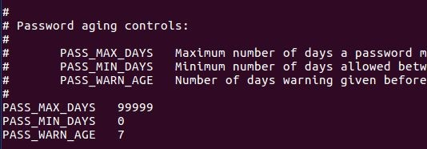
Conﬁg ﬁle /etc/login.defs
sudo nano /etc/login.defs: brings you to login.defs ﬁle to edit information
conﬁgures settings for password aging as well as general user account stuff
PASS_MIN_DAYS (minimum # of days a password can be used) → 8 days
PASS_MAX_DAYS (max # of days for certain password to be used) → 15 days
PASS_WARN_AGE (# of days before password is expired, gives warning) → 7 days

Slide 17
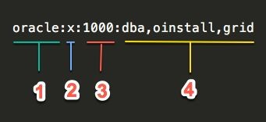
Conﬁg File /etc/group
- sudo nano /etc/group: brings you to the group ﬁle to conﬁgure it
- contains info about groups
group name
password
Group ID (GID)
Users in the group

Slide 18
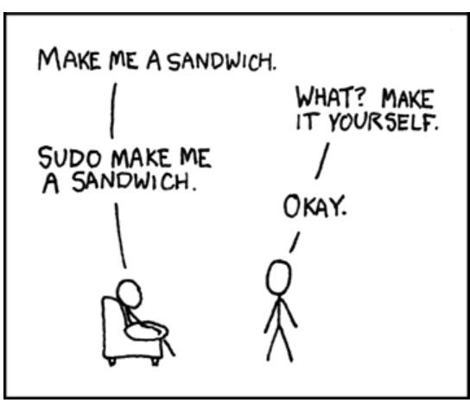
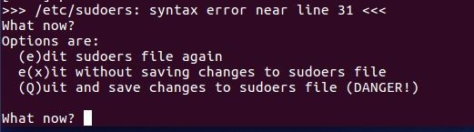
Conﬁg ﬁle /etc/sudoers
deals with users and capacity for them to use sudo
3 types of users:
sudo visudo (DO NOT USE NANO)
creates a duplicate ﬁle of /etc/sudoers(.tmp) to be edited
notiﬁes you of syntax errors and logs edits
-BE CAREFUL when editing this ﬁle

Slide 19
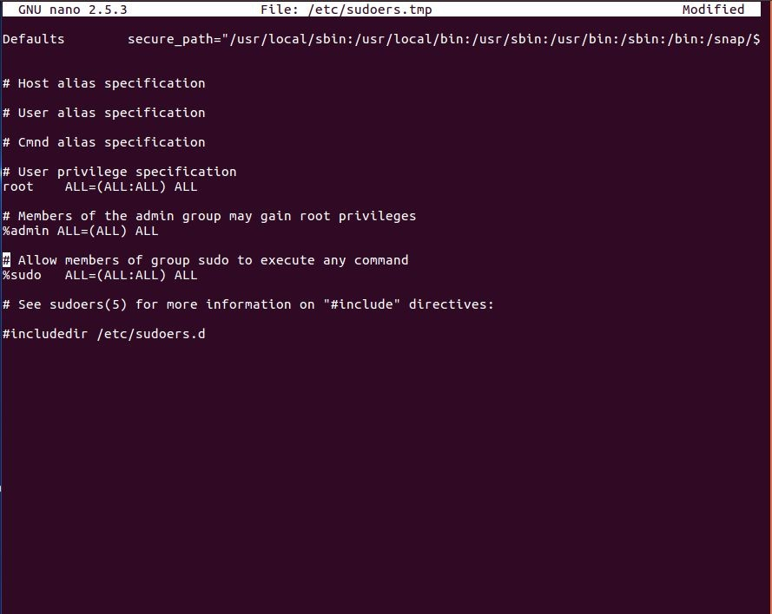
Default Conﬁg for /etc/sudoers
root ALL=(ALL:ALL) ALL
gives the root user unlimited privileges on the system and can use any command
%admin ALL=(ALL) ALL
%: notates a group
admin group has root privileges
make sure this is how the ﬁle looks like

Slide 20
Common problem in sudoers
Does anyone know what and “!” means in coding?
Knowing that, what does “Default
!authenticate” mean?
If you ever see that line in /etc/sudoers or the /etc/sudoers.d directory, remove the !
Why would we do that?

Slide 21

Guest Account
Ubuntu has a default guest account that people can log in to
security purposes: must disable the guest account
Ubu14: /etc/lightdm/lightdm.conf (conﬁgures the guest ﬁle)
Ubu16: make a ﬁle called 50-no-guest-conf in the LightDM conﬁg folder
/usr/share/lightdm/lightdm.conf.d/50-unity-greeter for Ubuntu 14
LightDM: display manager for Linux, disables guest account but also can be used for other user interface conﬁgs at login screen

Slide 22
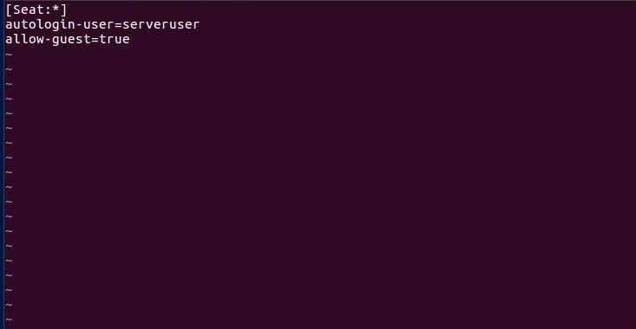
Default File for
/etc/lightdm/lightdm.conf
[Seat:*] or [SeatDefaults]
should be the ﬁrst line
autologin-user=serveruser
sets system to start the speciﬁed user to be logged in
- autologin-guest=true →
BAD
- allow-guest=true
- enables guest account (default)
- change to false to disable

Slide 23

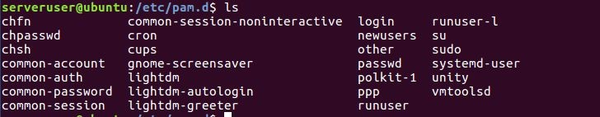
PAM in Linux
nope not this one
PAM (Pluggable Authentication Modules): large API that contains information about authentication and dictates the user’s authentication to certain services
account: checks for account veriﬁcation in relation to passwords or services
authentication: authenticates user and establishes credentials
password: updates user passwords, sets certain guidelines
session: manages actions taken at the beginning and end of sessions (after you log in)
access all of them by going to the /etc/pam.d directory

Slide 24
Format of PAM conﬁg ﬁles
-
-
module-type
: the diﬀerent modules in PAM (the four mentioned in the last slide)
control: determines how PAM will behave when a module fails
required: requests fails = denies authentication but runs through the stack
requisite: request fails = immediate denial of service/authentication
optional: request succeeds or fails = only signiﬁcant if only one there
suﬃcient: request succeeds, nothing else checked, fail → continue checking
-
-
module-path
: module you are referencing (pam_<module>.so)
arguments: certain options available from the selected module path to make
authentication more secure
- minlen=12, ocredit=-1, gecoscheck, etc.

Slide 25
Conﬁg for
/etc/pam.d/common-auth
auth [success=1 default=ignore] pam_unix.so nullok_secure
auth optional pam_tally.so deny=5 unlock_time=900 onerr=fail audit even_deny_root_account silent
auth required pam_tally2.so oneer=success audit silent deny=5 unlock_time=900

Slide 26
Conﬁg for
/etc/pam.d/common-password
install package libpam-cracklib (enforces password complexity)
password requisite pam_cracklib.so retry=3 minlen=12 lcredit=-1 ucredit=-1 dcredit=-1 ocredit=-1 difok=4 reject_username minclass=3 maxrepeat=2 gecoscheck enforce_for_root
password sufﬁcient pam_unix.so use_authtok obscure rounds=80000 sha512 shadow remember=7
use_authtok→ takes the previous successful password from another module & apply here
rounds=80000 → rounds of encryption for password
sha512 → uses sha512 algorithm to encode the password
remember=7 → system remembers certain amount of previous passwords

Slide 27
Parameters In Detail
pam_cracklib.so = references the cracklib module (compares w/ dictionary words)
retry=3 → # of times user can retype password
minlen=12 → minimum length
lcredit=-1 → # of lowercase letters in password
ucredit=-1 → # of uppercase letters in password
dcredit=-1 → # of digits in password
ocredit=-1 → # of characters in password
difok=4 → # of character changes from old password

Slide 28
Package Management
package: collection of ﬁles meant to run a certain task
apt-get [command] [package]: retrieves packages from source to use
install [package] → installs and/or upgrades packages
autoremove [package] → removes extra dependencies & packages
remove [package] → removes only the main package
purge[package] → removes the packages and any conﬁg ﬁles along with it
- add --autoremove to add another layer of removing
apt-get update → notiﬁes the system of new versions of packages if available
apt-get upgrade → actually updates the system’s packages if available
-

Slide 29
Package Management Pt.2
dpkg -l: lists out all packages installed on the system
dpkg -l | grep [package] → searches the package list
packages to look for: john, medusa, hydra, netcat, etc.
29

Slide 30
Quick Review of Conﬁguring the Software Update Center
There is a way to do this in /etc, but let’s go over the GUI way, because it’s easy to use.
System Settings -> Software & Updates
Ubuntu Software (Click two of them, nothing else)
Canonical-supported free and open-source software (main)
Community-maintained free and open-source software (universe)
Download from: Server for the United States

Slide 31
More on the Software Update Center
Other Software
Canonical Partners
NEVER cdrom
Updates (Check two)
Important security updates
Recommended updates
Check for updates Daily
When there are security updates: Download and install automatically
When there are other updates: Display weekly
Notify me of new Ubuntu version: Never
apt-get update
Updates the packages based on your new changes
apt-get upgrade

Slide 32
On to File Permissions...

Slide 33
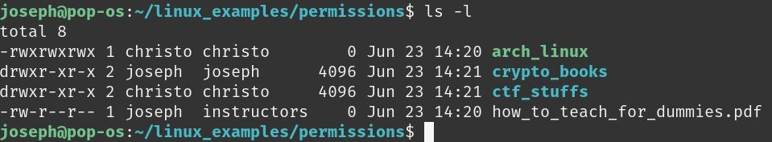
Permissions
File type (d for directory, - for most other ﬁles)
Owner
Other Users
Owner
Owner Group
Owner Group

Slide 34
The Simple Way to Change Permissions
sudo chmod [permission_set] <ﬁlename> sudo chown <new_owner> <ﬁlename> sudo chgrp <new_group> <ﬁlename>
To set permission set:
u,g,o +/-/= rwx
Ex: sudo chmod o-wx a_ﬁle
Ex: sudo chmod u+rwx,o=r a_ﬁle

Slide 35
The Harder, but Faster Way to
Set Permissions
how to convert binary to decimal:
start at the rightmost digit
that digit is 2⁰
the next digit is 2¹
then 2²,... and so on
1 means that the term exist. For instance, if the number is 001₂, that means that the 2⁰ term exists. 2⁰ is 1, so this number equals 1.
So let’s work through 101₂=
Remember, start from the right. 2⁰ exists, because there is a 1 there. 2¹ doesn’t. There is a 0 there. 2² exists because there is a 1 there. So… 2²+0¹+2⁰=4+0+1=5₁₀
Let’s start with a lesson on binary.
binary has 2 digits: 1 & 0 (true or false)
000 =0
2 10
001 =1
2 10
010₂=2₁₀
011 =3
2 10
100₂=4, etc…
₂2 ₂1 ₂0
Now tell me: What is 110₂?

Slide 36
The Harder, Faster Way, continued
So basically Linux can represent a permission set (rwx) as either yes-or-no (true or false) so 0 or 1. So if a ﬁle had rwxrwxrwx it would be like 111111111. But remember! A permission set is just a group 3 at a time so it’s more like 111 111 111. Based on the last slide, we can therefore turn it into 111₂=7₁₀. So if we wanted to set rwxrwxrwx to a ﬁle we can use the command:
chmod 777 <ﬁle name>
Instead of chmod =rwxrwxrwx <ﬁle name>
So what would it be if I wanted it to be rw-r--r--?

Slide 37
Permissions

Slide 38
Why Do We Care About Permissions?
If the wrong people have access to some of our important ﬁles, like /etc/passwd for instance, they can make changes that will leave our system vulnerable.
Knowing permissions also helps with Forensics questions like, “Who owns the image in the /home directory?”
To view both hidden ﬁles and permissions of ﬁles at the same time, use the command ls -la.

Slide 39
Forensics
forensics: ﬁnding information about a computer or system (broad)
CyPat: speciﬁcally information about OS, cryptography, or info about ﬁles
Google = friend because there’s always going to be something to research every round
Here are some tips and tricks:
check for hidden ﬁles (ls and its options are quite helpful)
understand your system
recognize certain patterns (hex, binary, etc.):
http://rumkin.com/tools/cipher/
look into ﬁnd and grep commands and their many options

Slide 40
Find command
looks for ﬁle names and directories
General Syntax: ﬁnd <ﬁlename/path>
to ﬁnd a speciﬁc ﬁletype: ﬁnd <directory> -name *.<ﬁle extension>
-name: matches the information that comes after it
* : displays EVERY ﬁle with said .<ﬁle extension>
directory: / (to be able to search through the whole system)
to ﬁnd hidden ﬁles: ﬁnd ~ -type f -name “*.”
-type: helps you to search by what you’re looking for (f= ﬁle, d= directory)
*. → shows hidden ﬁles (shown with a . before the ﬁlename)
There are A LOT more options and conﬁgurations, so do some research to ﬁnd out more about them!

Slide 41
Grep command
looks for patterns and expressions inside ﬁles and text
General Syntax: grep <pattern> <ﬁle>
to ﬁnd certain ﬁle type: ﬁnd <directory> | grep [.]<ﬁle extension>
|: pipe- funnels the output from ﬁnd command to be used by grep
searches for the ﬁle extension after all the ﬁles in the directory are shown
ﬁnd + grep together = pretty epic combination
bunch of things you can do with grep (can be used to search many different conﬁguration ﬁles) so research!

